Slide 1
GRD Project Document Translation
Team members:
Salman Abdulrazaq Ali
Anas Khalid
Mahmood Mohsin
Omer Abdulrahman
Abdulla Ali
Notes:
For Educators: You can use this template to help your students effectively present and communicate their project to a broader audience. Your students can also use this presentation as a portfolio of their work to demonstrate their cloud skills.
The presentation structure is listed below. The total time may vary depending on the activity you want to conduct. For example, you may want your students to provide high-level walkthrough of their final solutions versus deep-dive into why or how they chose certain services and the steps of building their architectures.
Suggested timing for a 15-minute presentation:
Introduction – 30 seconds
Business scenario overview – 1 minute
Solution overview – 5 minutes
Architecture diagram of the solution – 2 minutes
Demo – 5 minutes
Lessons learned – 1.5 minutes

Slide 2

The circumstances we encounter on a daily basis
Everybody have an issue in translation, especially accuracy with Arabic language.
These documents and the content within them are vital to supporting your business. Yet in many cases, the content is text-heavy and often written in a different language.
This limits the flow of information and can directly influence your organization’s business productivity and global expansion strategy.
Notes:
Define the problem or opportunity that you are addressing. Include pictures, figures, and statistics to help the audience better conceptualize the problem or opportunity.
Specify who your users or customers are and what pain points they are experiencing.
For example: “Users complain that the student admissions department website is too slow and isn’t always available.”
Also, list any specific business requirements that you are addressing.
For example: “Improve the experience for users. The web application can be deployed to the AWS Cloud. The application must be highly available, scalable, load balanced, secure, and performant architecture that can support thousands of users.“
Note:
An above-bar overview succinctly defines the problem and opportunity statement. For example: “Customers with media files, such as retail companies, need an easy and cost-effective way to analyze photos and videos of their inventory.”
A below-bar overview is too verbose, technical, or not specific. For example: “The most common media files are .jpg and .mp4. Companies have media files of their inventory.”

Slide 3

Proposed solution
Extract text from PDF documents and translate them into an editable document in a different language using Amazon Translate asynchronous batch processing. For a low-latency, low-throughput solution translating smaller PDF documents, you can perform the translation through the real-time Amazon Translate API.
Notes:
Explain at a high level what you have built.
For example: “I built a web application for a company to host their blog.“
Talk about why you chose certain parts of the solutions and any tradeoffs that you made. Focus on how you designed the solutions and how you applied the AWS Well-Architected Framework as part of the process (AWS Well-Architected Framework: https://docs.aws.amazon.com/wellarchitected/latest/framework/welcome.html).
For example: “I configured load balancers and auto scaling to make the application highly available and reliable.”
Include the use cases that you are addressing. Think about who your users are and how they would want to interact with your solution to solve their problem.
For example: “Users can view, upload, edit, and delete blog posts. Administrators can approve blog posts.”
Talk about the use cases that you addressed as part of the minimum viable product (MVP) that you scoped and built.
Note:
An above-bar description is concise and includes the most important benefits. For example: “The solution allows customers to quickly upload, store, and search large catalogs of images and videos in Amazon S3.”
A below-bar description is too detailed or not specific. For example: “Our solution analyzes media files.”

Slide 4
Solution Impact
The ability to process data at scale is becoming important to organizations across all industries. Managed machine learning services like Amazon Textract and Amazon Translate can simplify your document processing and translation needs, helping you focus on addressing core business needs while keeping overall IT costs manageable.
Notes:
Explain at a high level what you have built.
For example: “I built a web application for a company to host their blog.“
Talk about why you chose certain parts of the solutions and any tradeoffs that you made. Focus on how you designed the solutions and how you applied the AWS Well-Architected Framework as part of the process (AWS Well-Architected Framework: https://docs.aws.amazon.com/wellarchitected/latest/framework/welcome.html).
For example: “I configured load balancers and auto scaling to make the application highly available and reliable.”
Include the use cases that you are addressing. Think about who your users are and how they would want to interact with your solution to solve their problem.
For example: “Users can view, upload, edit, and delete blog posts. Administrators can approve blog posts.”
Talk about the use cases that you addressed as part of the minimum viable product (MVP) that you scoped and built.
Note:
An above-bar description is concise and includes the most important benefits. For example: “The solution allows customers to quickly upload, store, and search large catalogs of images and videos in Amazon S3.”
A below-bar description is too detailed or not specific. For example: “Our solution analyzes media files.”

Slide 5
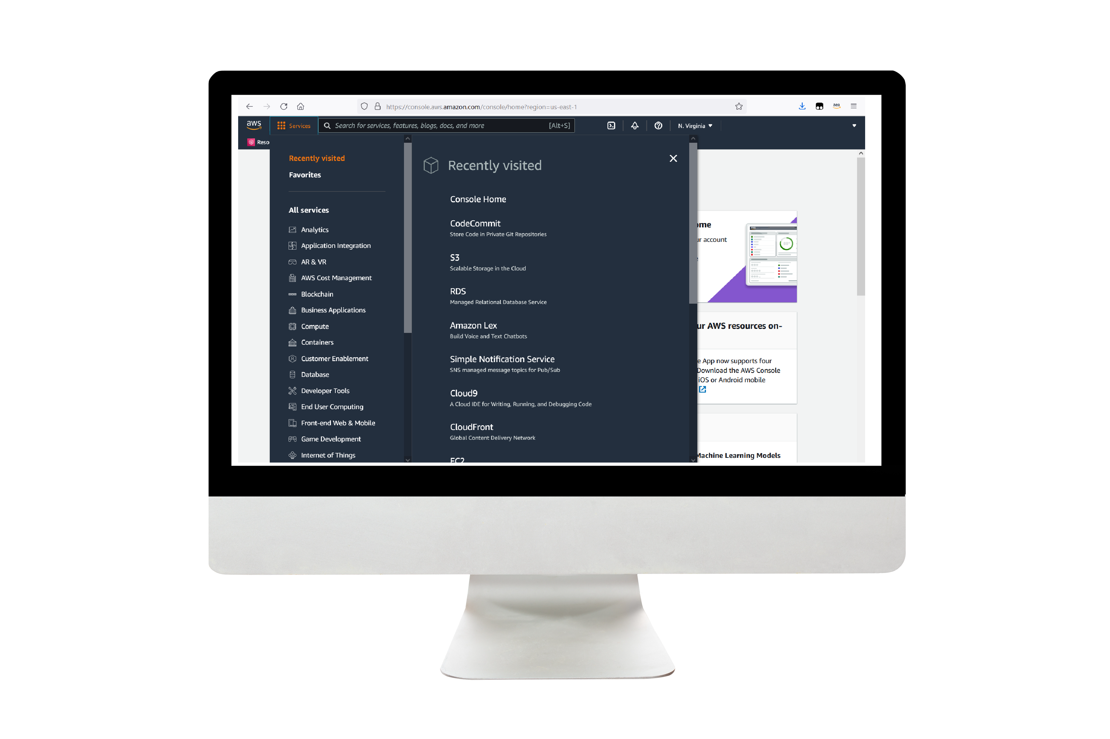
Solution Requirements
Amazon Simple Storage Service (Amazon S3) – Stores your documents and allows for central management with fine-tuned access controls.
Amazon Simple Notification Service (Amazon SNS) – Enables you to decouple microservices, distributed systems, and serverless applications with a highly available, durable, secure, fully managed pub/sub messaging service.
AWS Lambda – Runs code in response to triggers such as changes in data, changes in application state, or user actions. Because services like Amazon S3 and Amazon SNS can directly trigger a Lambda function, you can build a variety of real-time serverless data-processing systems.
AWS Step Functions – Coordinates multiple AWS services into serverless workflows.
Notes:
For the demo, guide the audience through the two to three most important benefits of the solution and how it addresses the requirements.
Your demo materials can be screen captures, recordings, a link to your final solution, and/or a link to AWS console.

Slide 6

Future implementation
Amazon SQS to queue the jobs and handle any potential failure related to throttling and default service concurrency limits.
It will support multi language translation.
We will make speech to speech translation by talking throughout the mic in your device.
Notes:
Explain at a high level what you have built.
For example: “I built a web application for a company to host their blog.“
Talk about why you chose certain parts of the solutions and any tradeoffs that you made. Focus on how you designed the solutions and how you applied the AWS Well-Architected Framework as part of the process (AWS Well-Architected Framework: https://docs.aws.amazon.com/wellarchitected/latest/framework/welcome.html).
For example: “I configured load balancers and auto scaling to make the application highly available and reliable.”
Include the use cases that you are addressing. Think about who your users are and how they would want to interact with your solution to solve their problem.
For example: “Users can view, upload, edit, and delete blog posts. Administrators can approve blog posts.”
Talk about the use cases that you addressed as part of the minimum viable product (MVP) that you scoped and built.
Note:
An above-bar description is concise and includes the most important benefits. For example: “The solution allows customers to quickly upload, store, and search large catalogs of images and videos in Amazon S3.”
A below-bar description is too detailed or not specific. For example: “Our solution analyzes media files.”

Slide 7
Thank you

